Slide 1
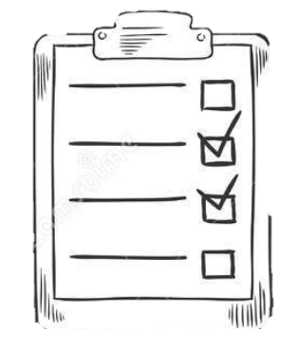

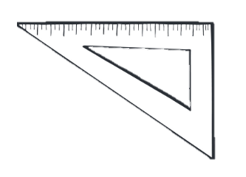
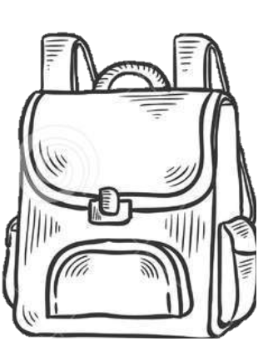

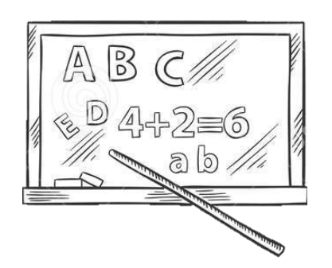



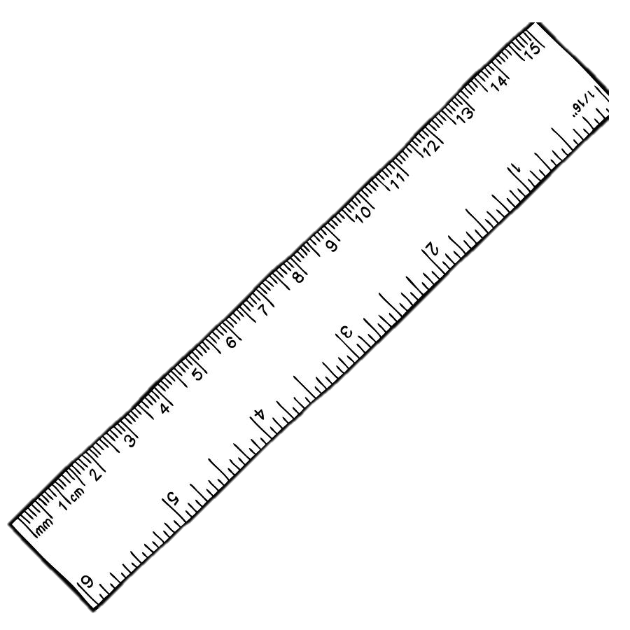













Crestview Elementary
$$=$$
$$\text{3−1=2}$$
X
$$\text{6×8}$$
$$\text{9÷3}$$
$$÷$$
$$\text{5}\text{×3}$$
1
Family
Math
Night
2
I
Math
3
$$=$$
$$÷$$
X
$$\text{9÷3}$$
I
Math
1
2
3
Make & Take Math Games Grades K-5
Take home resources to help support learning at home
$$\text{6×8}$$
Date: November 15th
Time: 5:00p- 6:00p
Location: Cafeteria
$$\text{3−1=2}$$
Crestview Elementary
151 Mark Walker Blvd Covington TN 38019
901-840-9300
ces.tipton-county.com
“All necessary accommodations are available for equitable participation.”
X
I
Math
$$÷$$
$$\text{5}\text{×3}$$

